Slide 1

Electricity
Prediction
Version 2
Group 2
Yu Song Ng
Wei Xiong Toh
Vibhu Krovvidi

Slide 2



Agenda
Problem and Business Value
Process and Change Management
Project Milestones and Timeline
Data Sources
Architecture
Model
Results 1
Results 2
Results 3
Challenges and Future Steps

Slide 3




Introduction
Multiple Time Series: Electricity Load Forecasting
Data: UCI Individual Household Electric Power Consumption dataset
370 Users, from 2011-2014

Slide 4

Problem
Electricity use varies over time of day, month, year due to various factors. Can we predict this use solely from the datetime data?
Objective
Predict electricity load in kW for a given datetime.
From:
To:
Electricity use data
Predicted electricity use

Slide 5
Timeline – Phase 1
Project Initiates
Project Phase 1 (Group 1)
Presentation
Sep 10
Sep 30
Oct 14
Nov
Dec
Feature Engineering
First model iteration
Q&A, Collaboration for smooth project hand-over

Slide 6
Timeline – Phase 2
Receive Project from Group 1
Project Phase 2 (Group 2)
Submission
Oct 14
Nov 1
Nov 20
Dec 1
Dec 16
Review Code, Audit Methodology
Test Code, Build Dashboard, Optimize Methods

Slide 7
Data
Contains the electricity load of 370 anonymous users (in kW) for each 15-minute interval
2011 to 2014
Training set: 2011-01-01 - 2014-03-31
Test set: 2014-04-01 - 2014-12-31
Aggregates 15 minutes to daily load (downsizing samples)
Expands with features for each user (ex. lags, means, standard deviations, year, month, etc.)
Normalize by each user’s mean and standard deviation
Clusters to groups based on the features

Slide 8
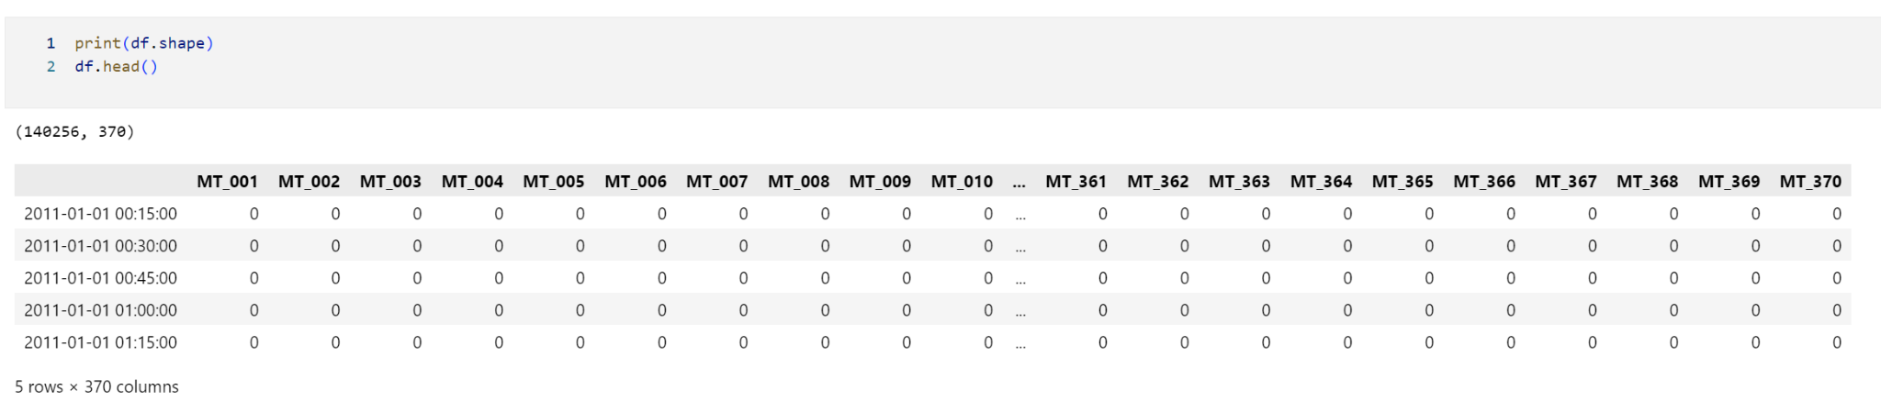
Data

Slide 9
Feature Engineering
Lags
Difference
Moving aggregate statistics
Mean
Standard deviation
Seasonal variation
Year, Month, Date, etc.
Day of week

Slide 10
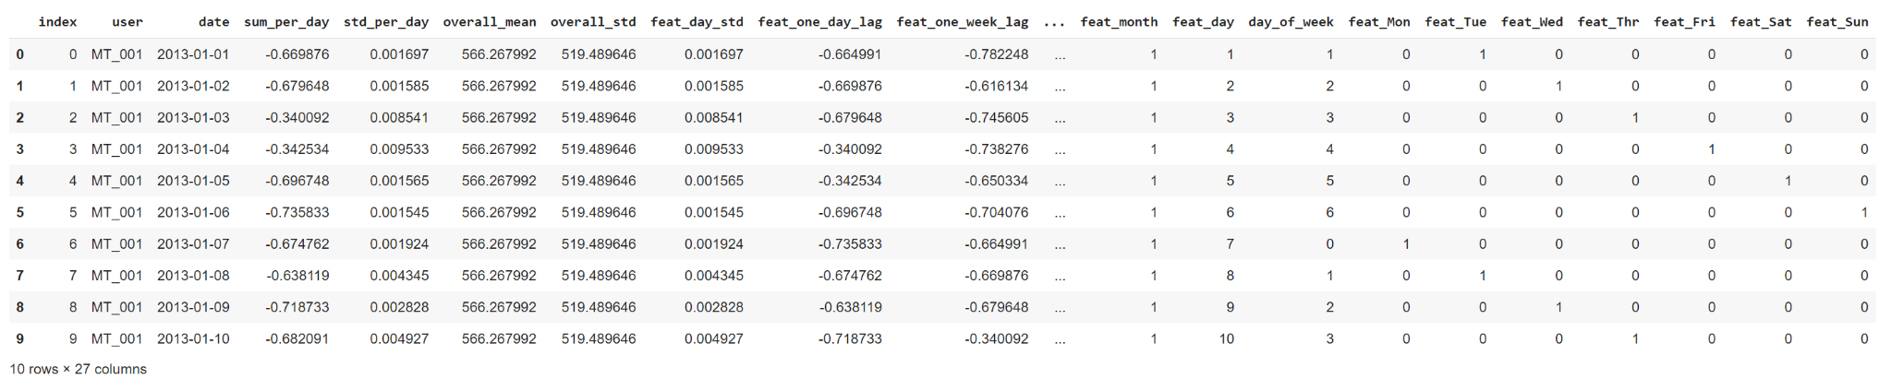
Feature Engineering

Slide 11
Evaluating Feature Engineering
Features created promote data leakage because metrics like overall mean, overall standard deviation take into account test data as well.
This means that the model will most likely overfit and will perform well on the test data
The reason is because the test data is not fully “unseen” in this case.
To overcome data leakage, we disregarded any metrics that were of current or prospective nature
Only metrics that can be reasonably computed without knowing the future were included as exogenous variables

Slide 12
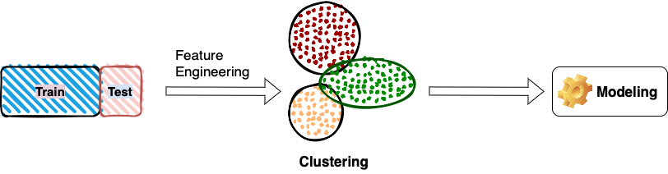
Pre-modeling
Feature Scaling
Rescale both the features and target to have:
mean of 0
standard deviation of 1
Training, Testing Pipeline/Iteration

Slide 13
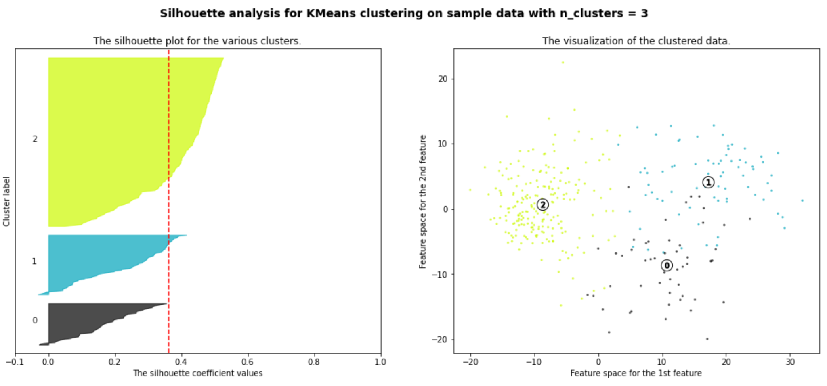
Pre-modeling: Clustering

Slide 14
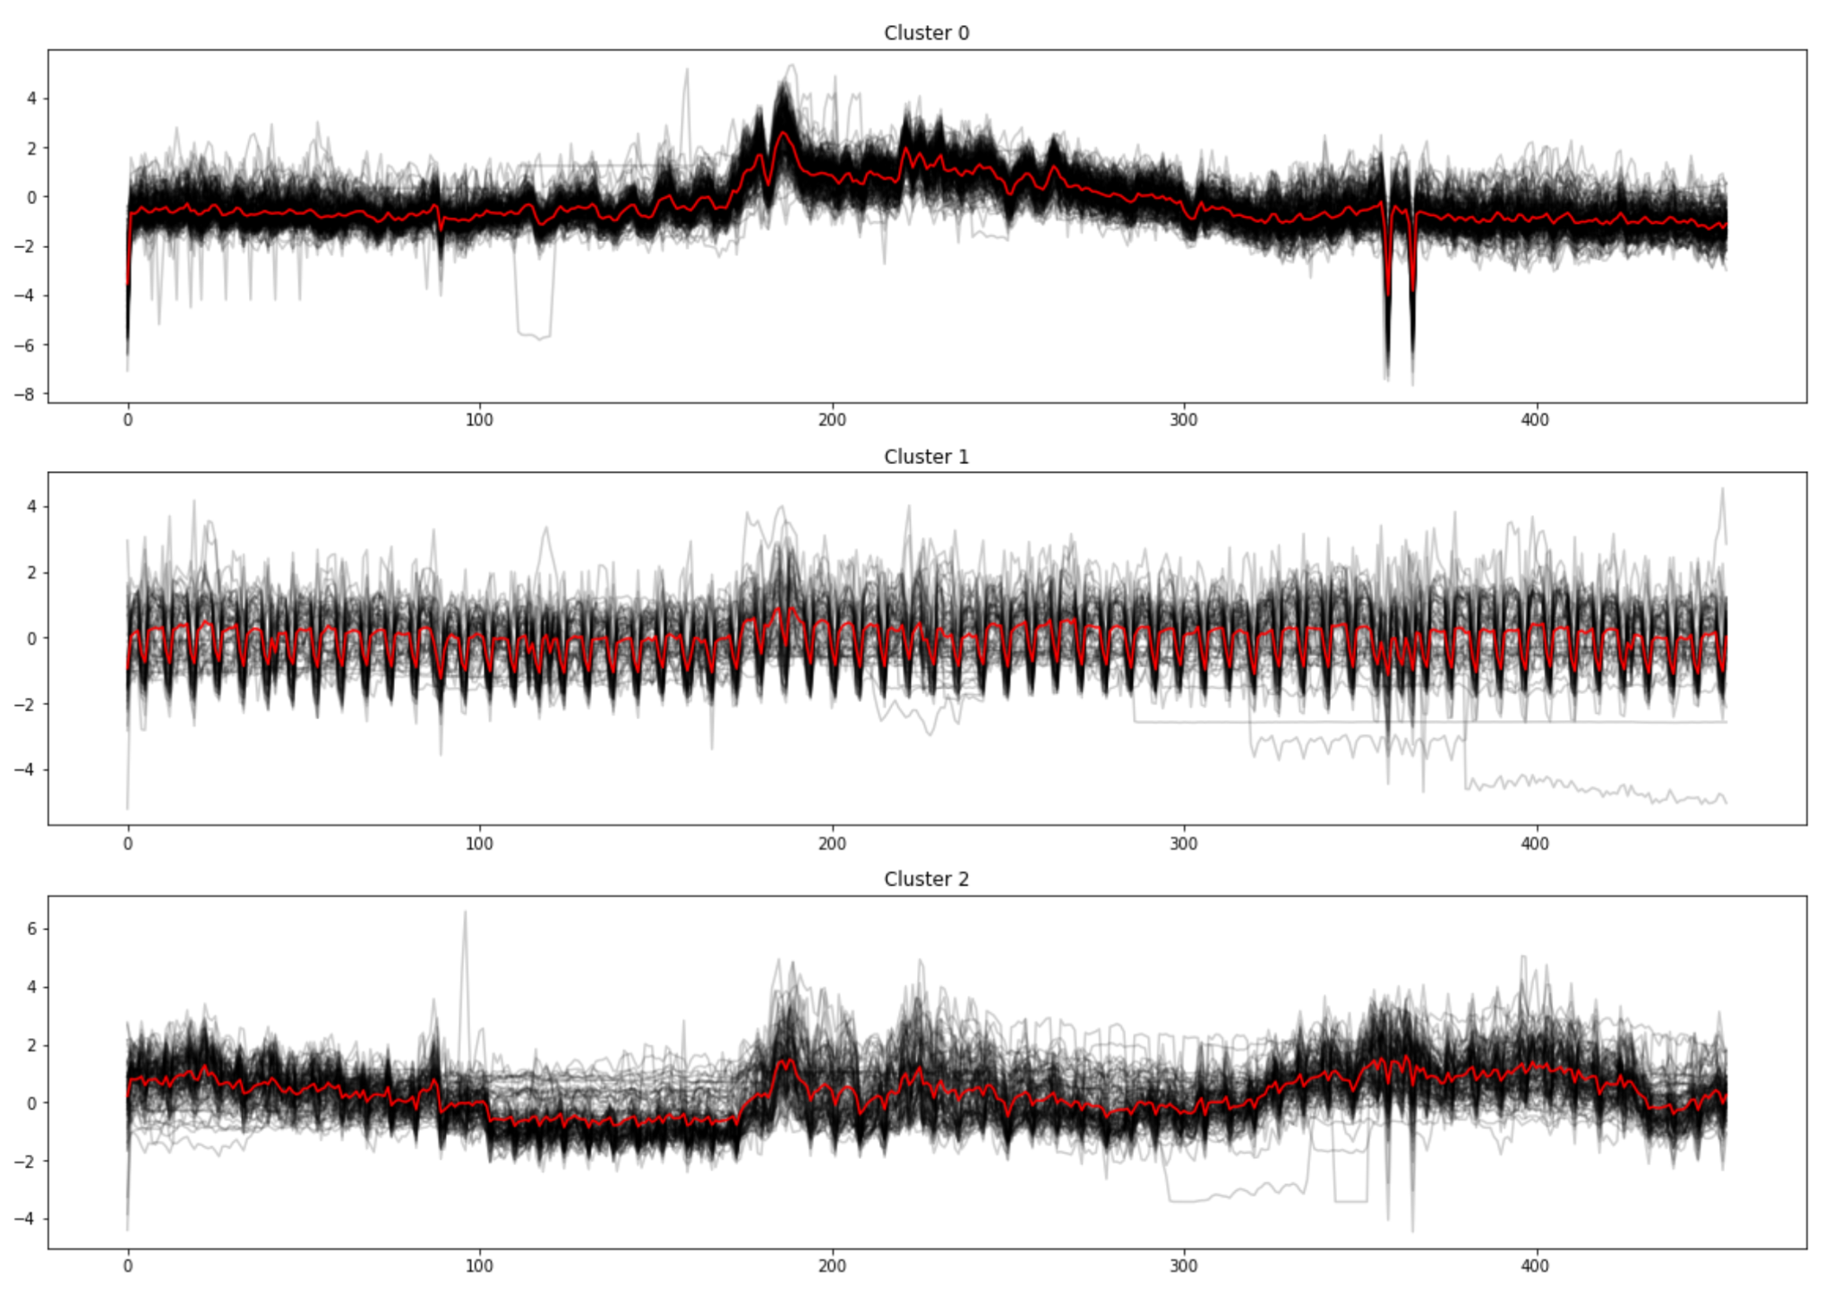
Pre-modeling: Clustering

Slide 15
Evaluating Clustering
The challenge of using only time series data in clustering is the lack of meaningful predictors of clusters apart from usage patterns.
Reality is that there are many external factors like location, usage purpose (business vs household) etc that are better metrics to categorize users on
Clustering introduces noise, increases variability and reduces accuracy of models
Therefore, we opted to disregard clustering in favor of targeted time series predictions for each individual user.

Slide 16
Model
Target | Category | Algorithms/Approach
1-day electricity load ahead | 1-step prediction | OLS Prophet Random Forest Gradient Boosting Neural Net
30-day forward prediction | 1-step prediction N-steps prediction/forecasting | Prophet Gradient Boosting (rolling) Neural Net
9-month/1-year forward prediction | N-steps prediction/forecasting | Prophet Gradient Boosting (rolling) Neural Net

Slide 17
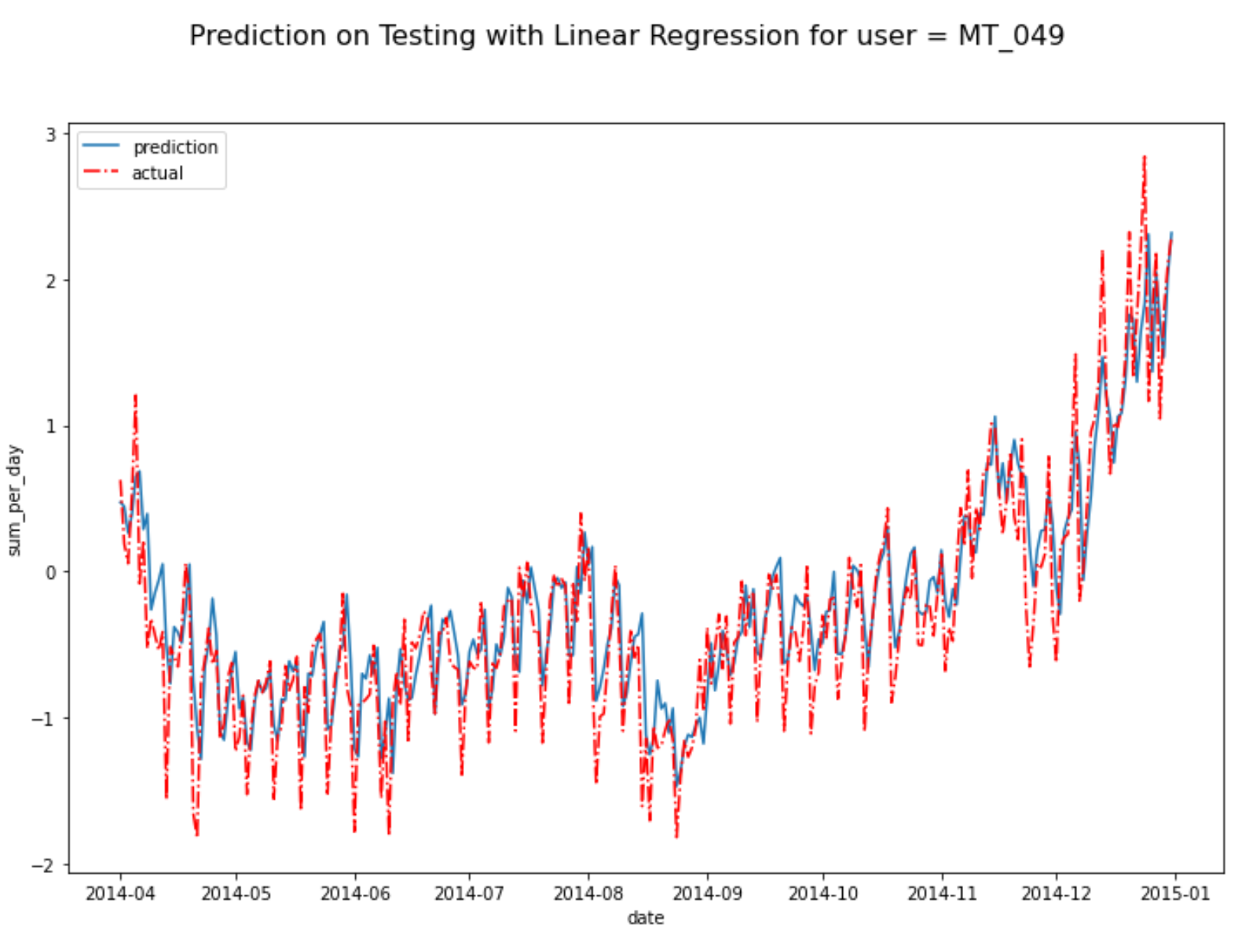
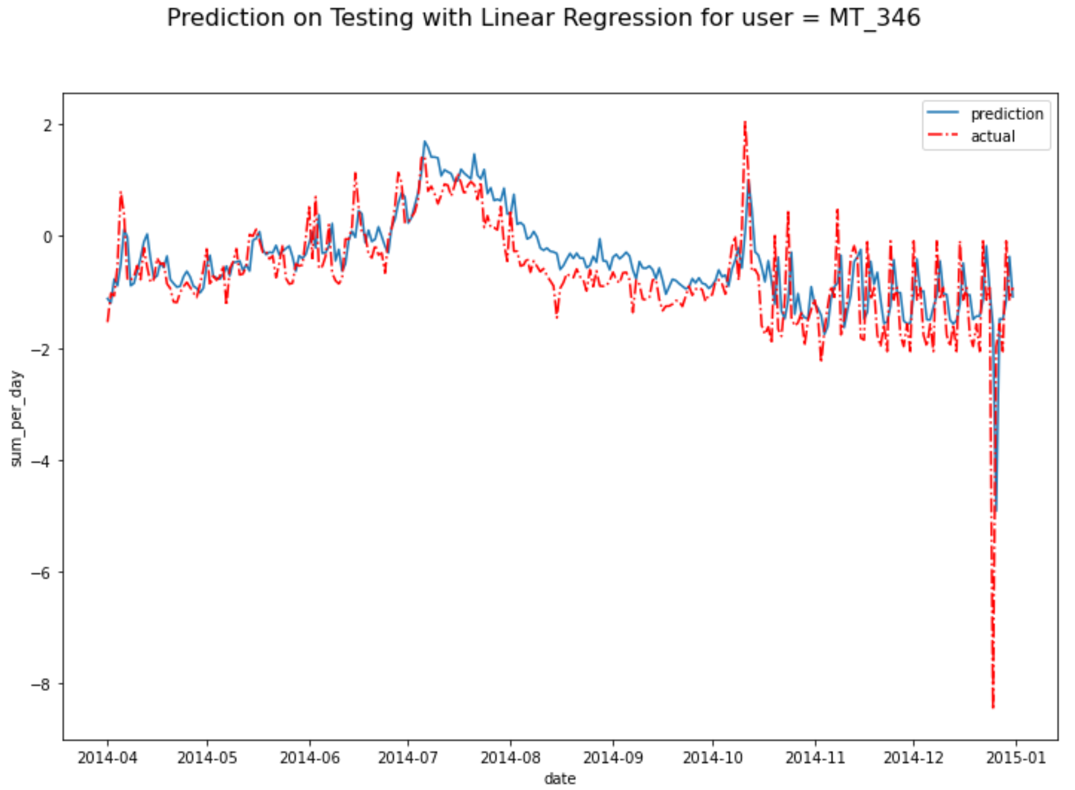
Results: OLS with Clustering

Slide 18
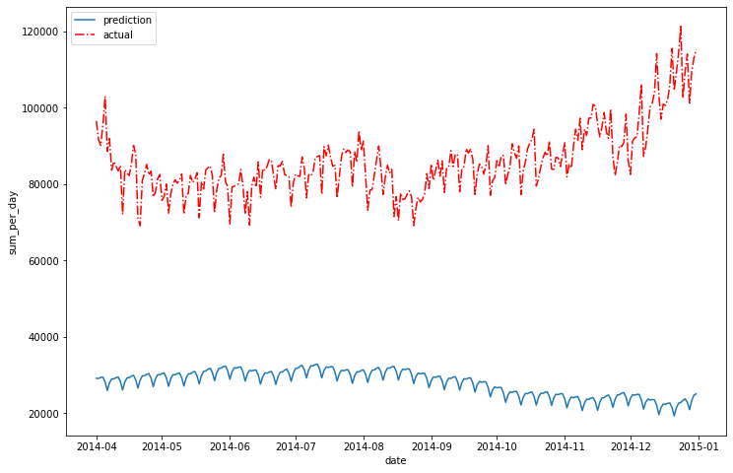
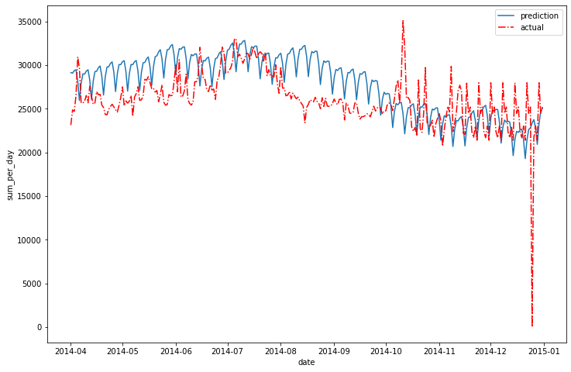
Results: Prophet with Clustering
MT_049
MT_346
Inconsistent fit, overall similar MAPE to OLS

Slide 19
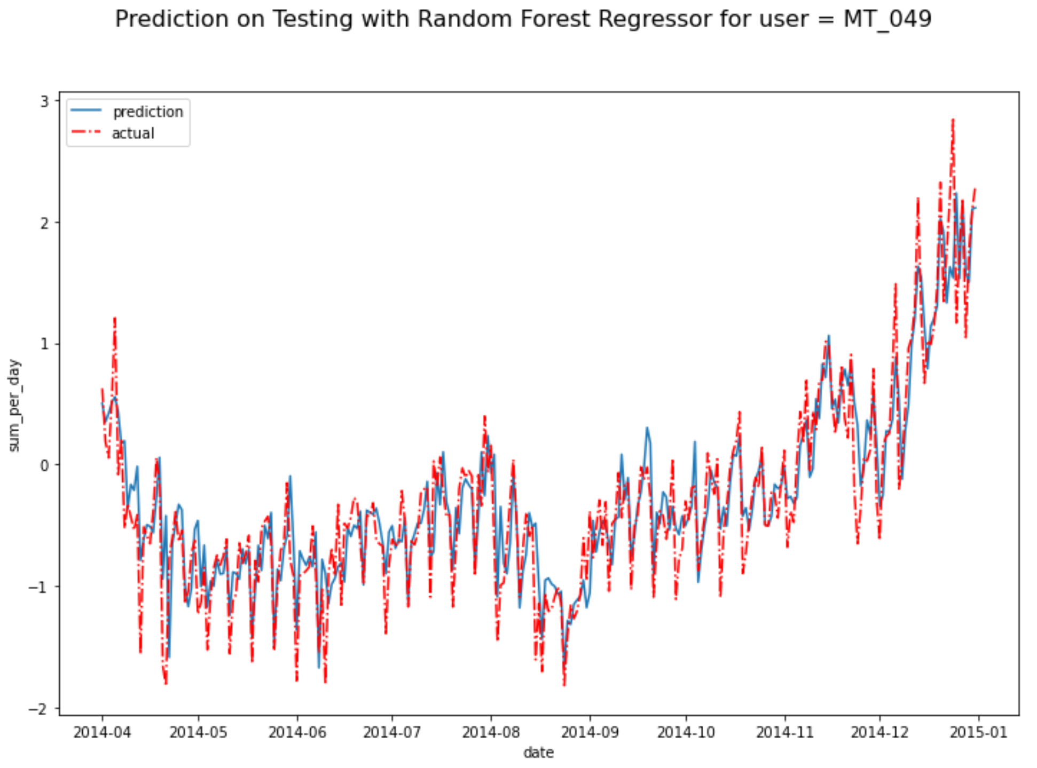
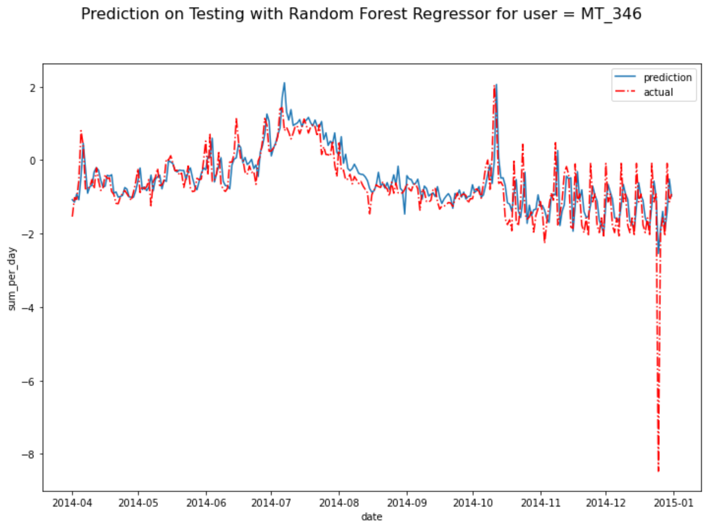
Results: Random Forest with Clustering

Slide 20
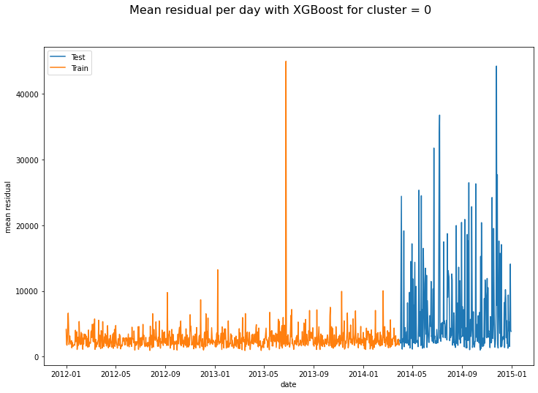
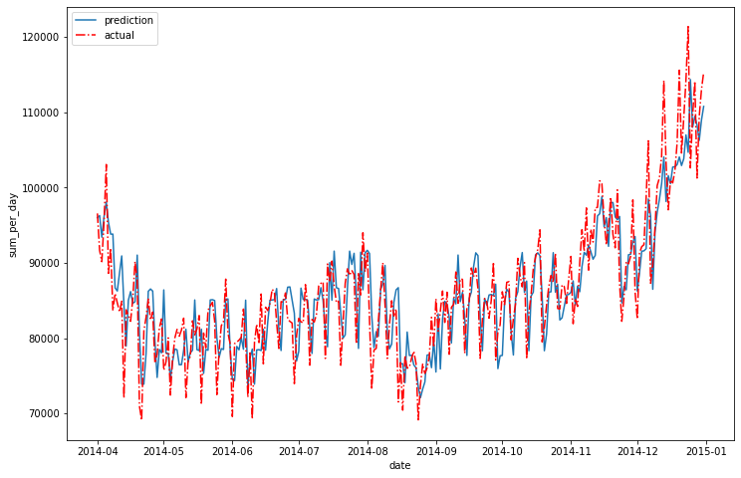
Results: XGBoost with Clustering
Compare RF to XGB
Prediction on Testing with XGBoost for user = MT_049
Similar performance to Random Forest
Fastest to train and predict by far!

Slide 21
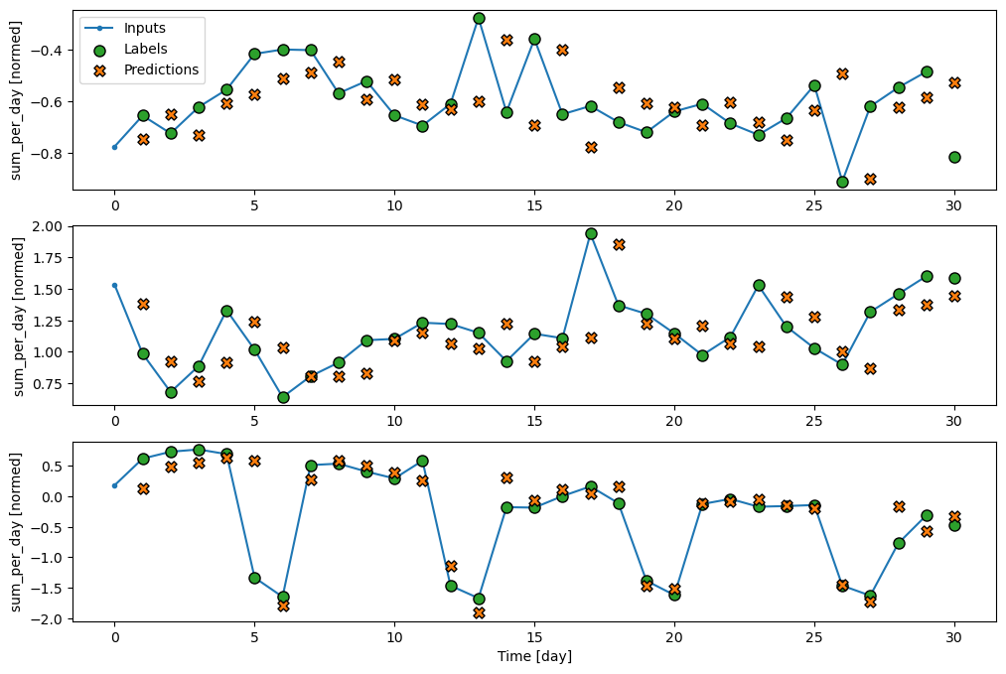
Results: Single-step LSTM

Slide 22
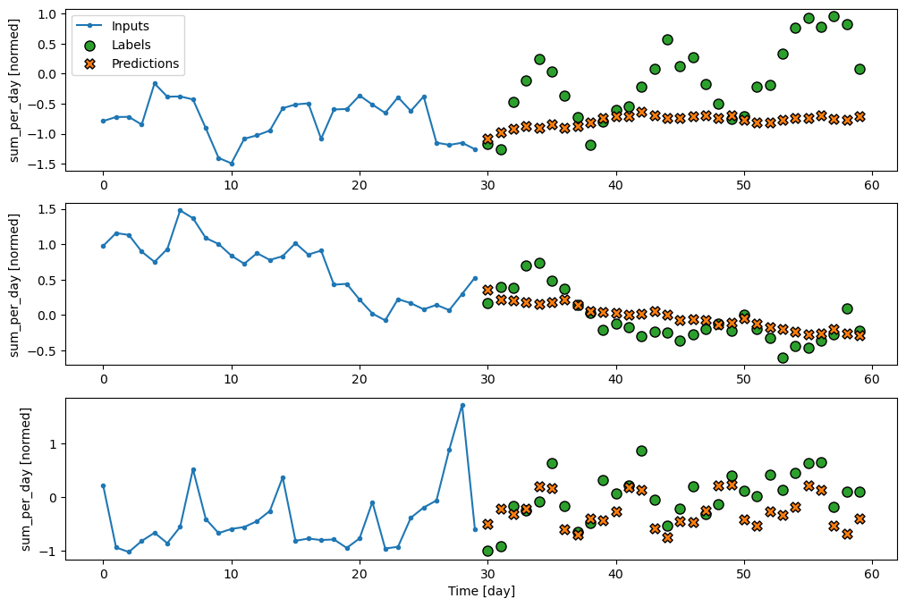
Results: Multi-step LSTM

Slide 23
Future steps
Clustering with more user information
location (ex. Northern/Southern Hemisphere)
diverse user with more trends
Holiday/event feature engineering
Olympic Sports
Christmas, Thanksgiving
Sophisticated model training
Increase model complexity by adding NN layers
Work with 15-min interval

Slide 24
End
Best performance: Gradient Boosting
Worst performance: Prophet
Least training time: Gradient Boosting (untuned)
Largest training time: Neural Network

Slide 25

Handover Rolling MAPE
Data Leakage implies these overstate performance!
Rolling MAPE | 1st 3-months | 2nd 3-months | 3rd 3-months
Prophet | 2.0450 | 2.4343 | 2.3261
XGBoost | 0.1695 | 0.2694 | 0.2087
LSTM | 0.4164 | 0.4443 | 8.347e16
MA+FC | 0.2712 | 0.7510 | 0.2958
Notes:
Rolling MAPE
1st 3-months
2nd 3-months
3rd 3-months
Prophet
2.0450
2.4343
2.3261
XGBoost
0.1695
0.2694
0.2087
LSTM
0.4164
0.4443
8.347e16

Slide 26
Revised Models - ARIMA
For each user, an ARIMA model was fitted based on auto_arima
By combining Autoregressive, Integrated and Moving Average terms, the ARIMA model is able to leverage the underlying structure of the data to make good forecasts
The addition of exogenous variables and a potential seasonal component i.e. SARIMAX further strengthens this
The best model by MAPE across all 3 time horizons was maintained for each user

Slide 27

Summary
We explored different model architectures and feature engineering techniques in order to achieve the best possible predictive power. Through careful iteration and experimentation, we created an accurate and efficient final model. Furthermore, the model can be scaled to include new users and new data.

Slide 28



Team – Group 2
Vibhu Krovvidi
Yu Song Ng
Wei Xiong Toh

Slide 29

Team – Group 1
Santos Hernandez
Jinyu Wang
Fanjiaxuan Zhang
Wenbo Zhao

